Slide 1
Amplified Leicester and the Resilience Imperative
Andrea Saveri
Amplified Leicester Showcase, April 15, 2010
Phoenix Square Digital Media Centre
Leicestershire, UK

Slide 2
A Call to Action
To develop flexible response capacities…
…for a new, complex problem space.

Slide 3
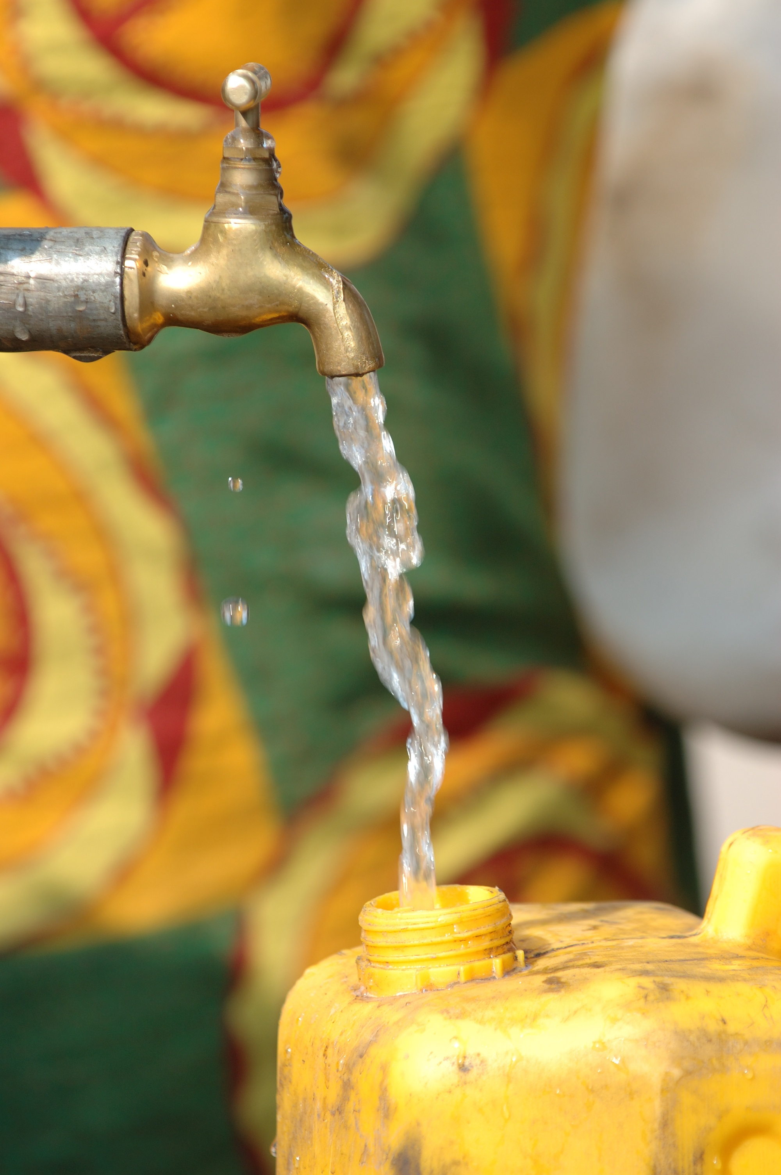
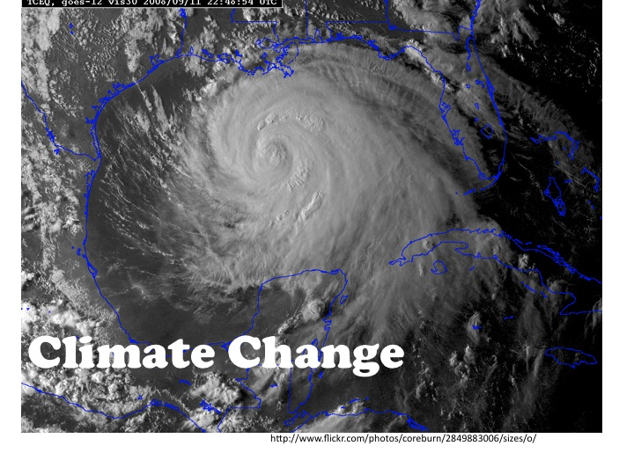
Water
Global Consumption
Financial Crisis
http://www.flickr.com/photos/andresrueda/3027534098/sizes/o/
http://www.flickr.com/photos/julien_harneis/589759829/sizes/o/
Notes:
water tap photo
http://www.flickr.com/photos/julien_harneis/589759829/sizes/o/
Financial crisis
http://www.flickr.com/photos/andresrueda/3027534098/sizes/o/

Slide 4
A Shift in Response Tools
Past
Fact Based
Analytical
Reductionist
Reliable Solutions
Best Practice
Future
Pattern Based
Intuitive
Generative
Valid Solutions
Novel Practice

Slide 5
Amplified Communities Use social media… …to generate new patterns, reconfigure, and learn.

Slide 6
A Culture of Resilience Network Power Design Capital Transformation Outlook

Slide 7
Network Power Ability to use social media to coordinate people, resources, and information to catalyze group action.

Slide 8
Sources of Power
Content
Transactions
Facilitation
Notes:
Facilitation not content - Source of value - Reed GFN. Super empower groups 21 century literacies – HLR, skill + community

Slide 9
Design Capital Practices and relationships that enable human-focused, system-wide problem solving.

Slide 10
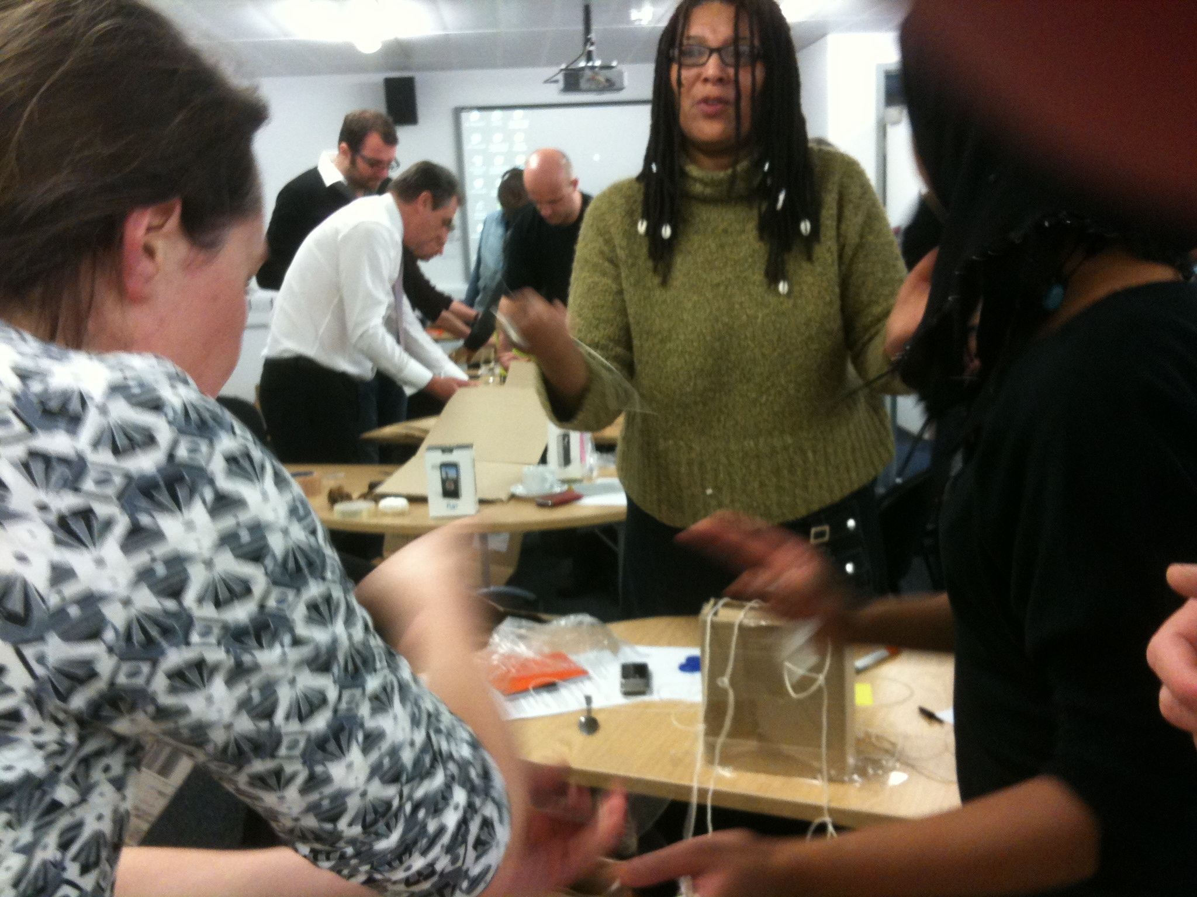
Prototyping
Empathy
www.flickr.com/photos/sue_thomas/4274031373/sizes/o/in/set-72157621895358974/

Slide 11
Transformation Outlook A growth mindset for engaging with change and a mythology of interdependence.

Slide 12
Mindsets Frame Interpretation Carol Dweck – Stanford University
Fixed
Growth
Talents & abilities carved in stone
Proving oneself
Shun resources
Outcomes
Talents & abilities cultivated over time
Improving oneself
Open to resources
Process, effort

Slide 13
Failure: An Action not Identity
A way to structure resources, options, new relationships
Feedback on how/what not who
http://www.flickr.com/photos/smemon/4497590005/sizes/o/
Notes:
http://www.flickr.com/photos/smemon/4497590005/sizes/o/

Slide 14
Reveal the work of change
Reward & honor effort and process
Adjust timeframe
Revise metrics of success
new connections, resources, assets

Slide 15
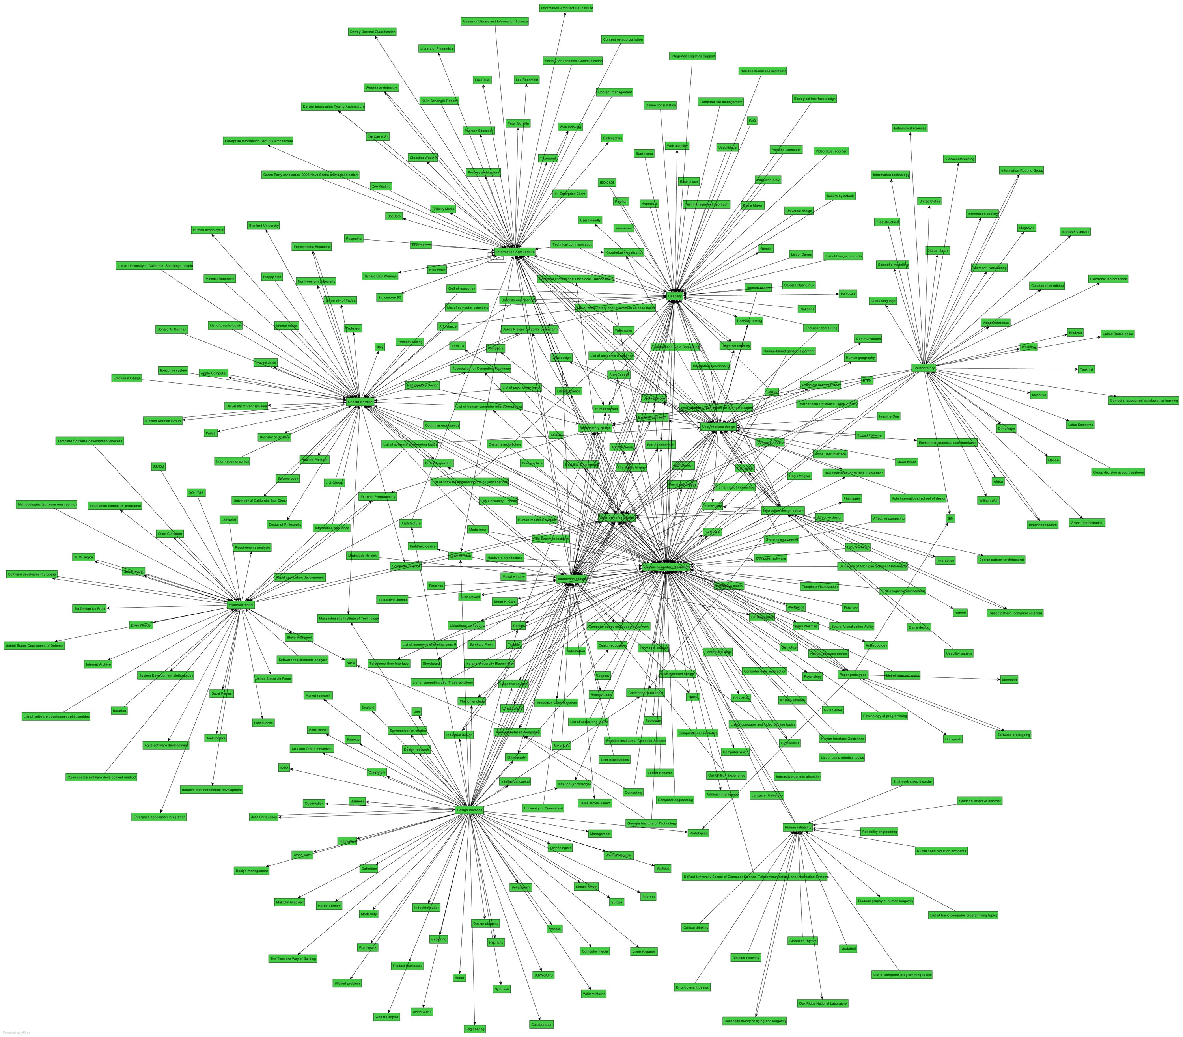
A Mythology of Interdependence
“Myths struggle to catch up with our reality.” Paul Saffo
http://www.flickr.com/photos/juhansonin/407874864/sizes/o/
Notes:
http://www.flickr.com/photos/juhansonin/407874864/sizes/o/ wikipedia topics mapped
Amplified communities are highly interdependent.

Slide 16
Role for Social Media
Make transformation visible
- map projects, partners, networks
Reveal the process: wikis, blogs
Open for feedback
Narrate interdependence

Slide 17
Amplified Leicester 2010
Empowered groups
Community-based prototyping
Visible process
Tuning an outlook
Stories of collaboration

