Slide 1
20:20 Vision Symposium
University High School
October 28, 2013
Notes:
Call from Alex: first question, how long is your future? 2020 is only 6-7 years away. What kind of perspective does that give us? What kind of issues? Solutions?
Peet’s Coffee experience: “You’ll have to wait.” “How long?” “90 seconds” Expectation of immediacy, quick cause and effect. And it is exactly the separation of cause and effect that makes our most pressing challenges so complex.

Slide 2
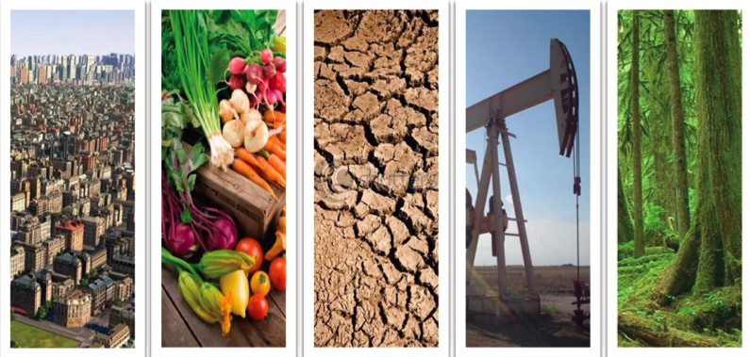
The Challenge Landscape
Notes:
2/3 of world population will live in cities 2030 – 61%
2.3 billion people won’t be able to meet their basic water needs
Global food supplies will have to double to feed everyone
The available flow of oil will severely decline
Half of our remaining rainforest will be gone – home to thousands of species of plants, animals, bacteria – source of medicinal compounds, oxygen.
From simple to complex - Wicked Problems
(social messes)
Hard to define
Systemic (nested)
No stopping
Poor measures

Slide 3
Time and Responsibility
“Nobody can save the world, but any of us can help set in motion a self-saving world—if we are willing to engage the process of centuries, because that is where the real power is.”
Stewart Brand, Long Now Foundation
Notes:
It is our responsibility to take the long view
We owe our existence to our ancestors, 10,000 years ago, to leave the world in good shape for the next 10,000.

Slide 4
Long Term Impact
“The goal of any forecast is not to predict the future but to tell you what you need to know to take meaningful action in the present .”
Paul Saffo, Discern

Slide 5
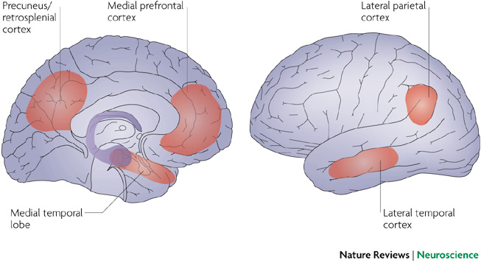
Temporal Exhaustion
Notes:
Emotional discomfort – need to change perspective – need tools to make sense of future possibilities
http://www.nature.com/nrn/journal/v8/n9/abs/nrn2213.html
Remembering the past to imagine the future: the prospective brain
Daniel L. Schacter¹, Donna Rose Addis¹ & Randy L. Buckner^{1,2} About the authors
A rapidly growing number of recent studies show that imagining the future depends on much of the same neural machinery that is needed for remembering the past. These findings have led to the concept of the prospective brain; an idea that a crucial function of the brain is to use stored information to imagine, simulate and predict possible future events. We suggest that processes such as memory can be productively re-conceptualized in light of this idea

Slide 6
Pace Layers of Change
Notes:
One of the tools we use to help us think long term is Stewart Brand’s framework of Pace Layers. A framework for thinking about civilizations over time.
The fast and slow layers work together to create resilience. Interaction of layers that creates the dynamic of civilizations.
a pace-layered cross section of civilization, whose components operate at importantly different rates. Fashion changes quickly, Commerce less quickly, Infrastructure slower than that, then Governance, then Culture, and slowest is Nature.

Slide 7
Achieving Resilience
Fast Layers
Learn
Propose
Absorb
Slow Layers
Remember
Integrate
Constrain
ATTENTION
POWER
Notes:
The fast parts learn, propose, and absorb shocks; the slow parts remember, integrate, and constrain. The fast parts get all the attention. The slow parts have all the power.
This is a way that we can look at issues and help us ask better questions and understand where and how we we might intervene
Also how to explore innovations and understand what they may mean for us in the long term.

Slide 8
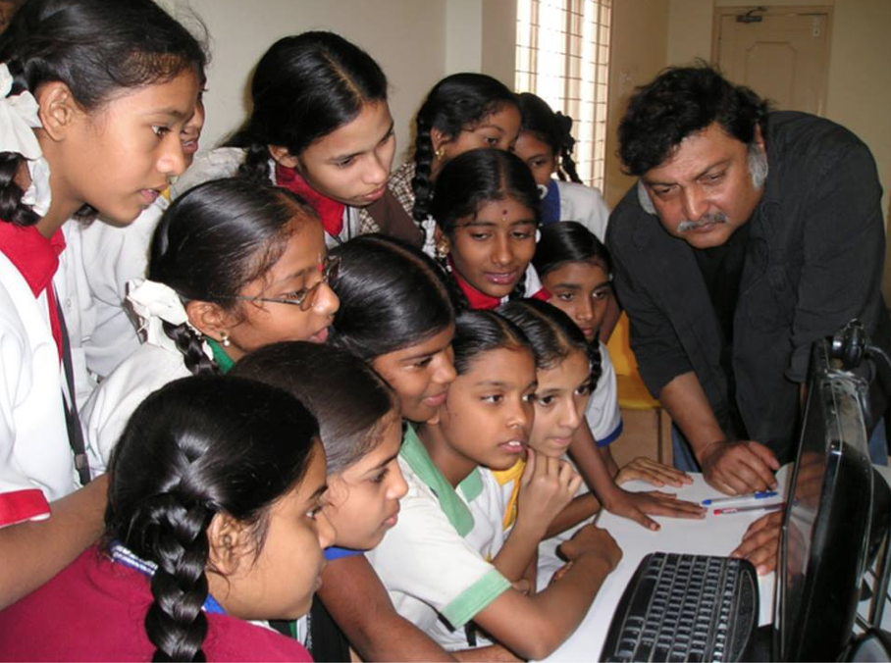
Self-Organizing Learning Environments
http://blog.tedprize.com
Wired.com
Notes:
Let’s look at change in Education
Sugata Mitra’s School in the Cloud Recent Story in NYT about Teacher and classroom in Matamoros, Mexico.
Broadband
Collaboration
Encouragement and Admiration
José Urbina López Primary School sits next to a dump just across the US border in Matamoros, Mexico
Sergio Juárez Correa got tired of teaching the government curriculum, tried something new SOLE – online to learn how.

Slide 9
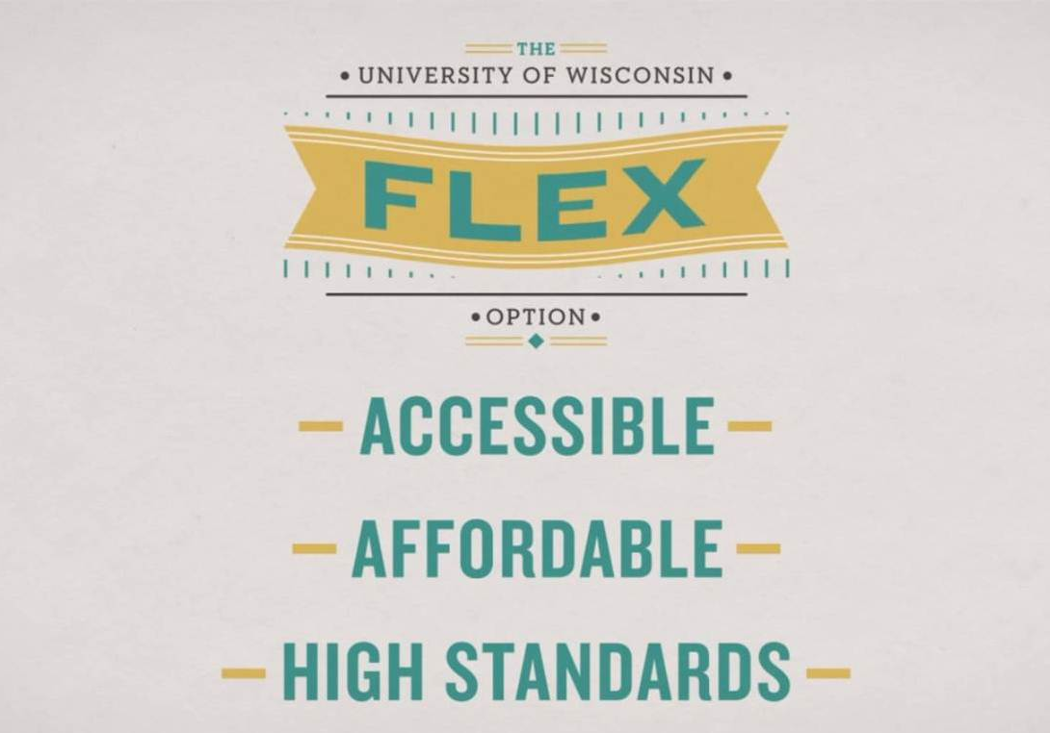
SOLE + DIY Credentialing
Notes:
When self organizing learning environments meet new forms of collaboration and new forms of credentialing then the infrastructure is challenged. Market driven. Something really new is being proposed by the fast layers. How will the infrastructure, culture respond?

Slide 10
In a world of abundant information, inexpensive communication channels, multiple learning platforms, what do self-learners need to know in order to effectively teach & learn from each other?
Notes:
Impacting the cultural layer
UnCollege
Hack your education
Lifelong learning

Slide 11
Hyper Palatable Foods and Conditioned Hyper-eating
New York Times 2009
Notes:
Let’s look at the food system
Process of human evolution created an equilibrium in our bodies for the amount of calories we need and the level of activity that we do
Commerce and infrastructure layers have aligned to create a food system that is destructive to our health and to natural resources – depleting energy, soil, water intensive
“The End of Overeating,” Dr. Kessler finds the food industry has combined and created foods in a way that taps into our brain circuitry and stimulates our desire for more
Foods rich in sugar and fat are relatively recent arrivals on the food landscape
by combining fats, sugar and salt in innumerable ways, food makers have essentially tapped into the brain’s reward system, creating a feedback loop that stimulates our desire to eat and leaves us wanting more and more even when we’re full.
“hyper-palatable food that requires little chewing and goes down easily,” biological challenge made more difficult by the over-stimulating food environment that surrounds us.

Slide 12
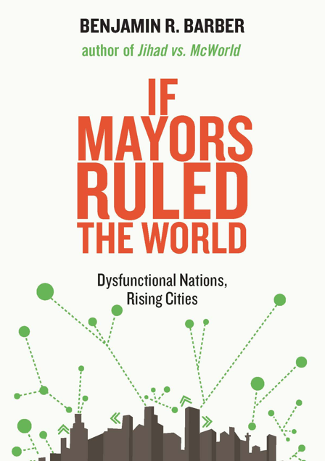
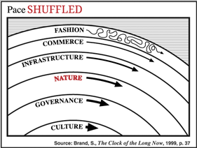
Climate Shuffling Layers?
Notes:
Climate is nature coming up to hit us. The question I’m asking as an ecologist and an environmentalist these days is: Can democracy handle climate change?
thought of it visually, as a shuffle of the layers — the implication being that the pace of nature’s change starts to move faster than that of governance.
Benjamin Barber: If Mayor’s Ruled the World

Slide 13
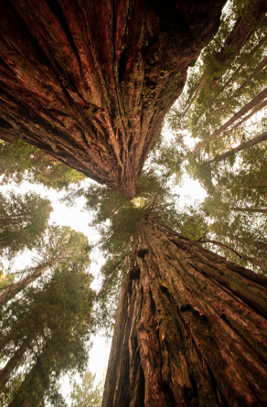
Long Term Futures at CSU-EB
To practice our “long now” thinking muscles.
Education is less about the statements we make and more about the questions we ask.
Notes:
Purpose is to develop and exercise our long now thinking.
Working with Dr. Lonny Brooks in the Department of Communications and Media to develop lessons to help students think long term, ask long questions, not be scared of exploring the long term future. Prevent Temporal Exhaustion.
Think about the past 10,000 like we think about last week and think about the next 10,000 years like it is next week.

Slide 14
Long Term Futures Constructs
Gender in the Media
100 year time horizon
Bio-innovation and Human Potential
Organizational Transformation
5,000 year time horizon
Ancient Forests
Notes:
How to set up the class to think about the long term future, ask questions and explore pace layers.

Slide 15
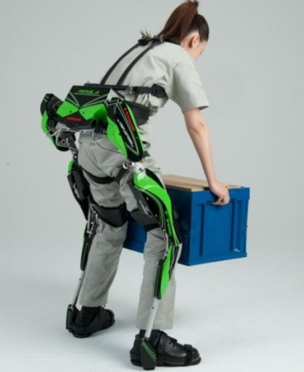
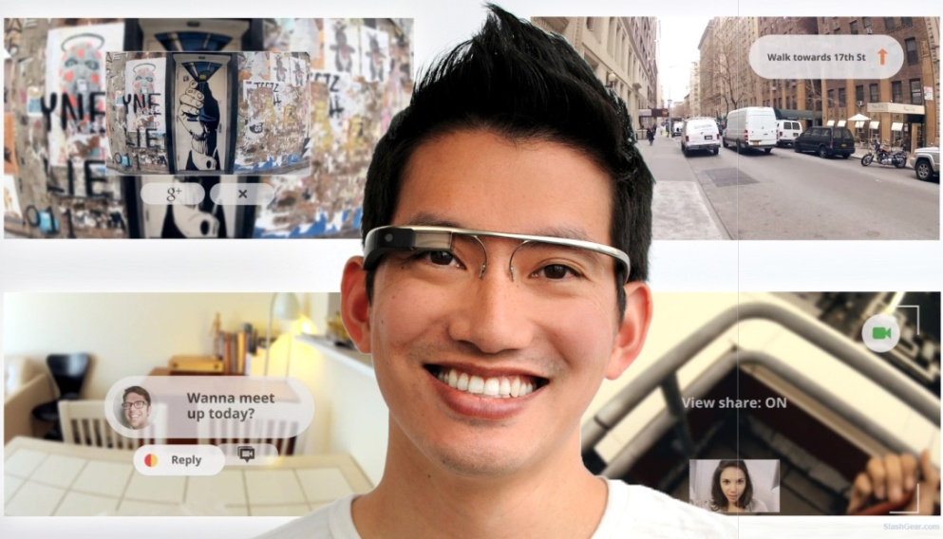
IDBIO Products: Expanding Human Potential
OptiCog Aids
ExoStrong
NuGender
Notes:
In 2015 a group of neuroscientists, molecular scientists, and social researchers launch IDBIO, a design firm for Identity and Bio-Power. Taking cues from the leading design firm IDEO, they explore and prototype the radical redesign of being human.
Their innovation portfolio focuses on solutions for
cognitive optimization (ranging from cognitive prosthetics to cognaceuticals), physical super-performance – suite of exoskeleton offerings
and gender design.
They know that many of their products are edgy and may not be ready for prime time in Des Moines or Wichita, despite early success in early adopter markets in the San Francisco Bay Area, New York City, Tokyo, and Sao Paulo. They are tasked to think 100 years in the future about the long-term implications of their bio-innovation innovation portfolio.
http://www.digitaltrends.com Kawasaki Robotic Exoskeleton
Cyberdyne employees wearing the robot-suit HAL (Hybrid Assistive Limb)
Lockheed Martin XOS exoskeleton – speed and endurance
At a recent strategy meeting, IDBIO’s Director of User Experience shared a key insight that all of their product groups would have profound impact on gender roles—both biologically designed and socially constructed. This was both a challenge and opportunity for IDBIO. Get it right and they could shape the new platform for gender experience and identity globally. Conversely, they could help usher in a new world of gender sabotage, inequity, and new forms of gender discrimination.
A core principle of IDBIO’s creative process is extreme provocation – drop any and all assumptions and imagine unthinkable possibilities. To help them think about the very long term implications of their product groups they decided to team up with Hollywood transmedia producers and create Gendered Lives 2112 a reality program in which a town in the U.S. adopts a suite of bio-innovations that dramatically change their human capacities and gender identification. The GL2112 town will provide a look at daily life with super-human capacities and flexible gender identity through the lens of social roles.

Slide 16
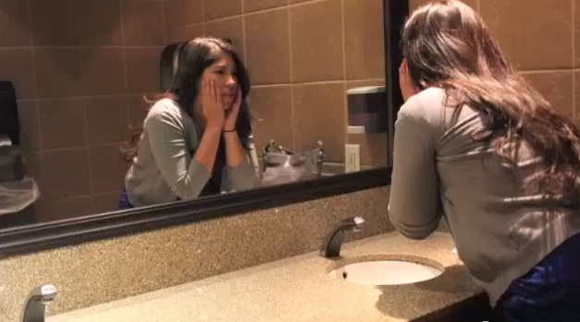
GL Town 2112: G – Switch
Al X
24 years old
MAAB
Designed in Utero
Desires gender switch
Notes:
This is what we gave the class: READ IT
“IDBIO’s Director of User Experience shared a key insight that all of their product groups would have profound impact on gender roles—both biologically designed and socially constructed. This was both a challenge and opportunity for IDBIO. Get it right and they could shape the new platform for gender experience and identity globally. Conversely, they could help usher in a new world of gender sabotage, inequity, and new forms of gender discrimination.
A core principle of IDBIO’s creative process is extreme provocation – drop any and all assumptions and imagine unthinkable possibilities. To help them think about the very long term implications of their product groups they decided to team up with Hollywood transmedia producers and create Gendered Lives 2112 a reality program in which a town in the U.S. adopts a suite of bio-innovations that dramatically change their human capacities and gender identification. The GL2112 town will provide a look at daily life with super-human capacities and flexible gender identity through the lens of social roles.

Slide 17
Waves of Bio-innovation
Bio-Design
Bio-Augmentation
Growth
Bio-Enhancement
2000
2050
2112
Notes:
How do we get to design - Three waves of bio-innovation for human potential and identity
First phases are situated more in the infrastructure layer of science, medicine – in making up for human deficiencies, and in the governance layer – military.
This leads to further developments of the technology and affordability
The design phase takes off when it reaches the market phase and intersects with fashion – that is when it starts to challenge gender roles.
Issues:
Do traditional gender roles get reinforced? Women can use physical, cognitive enhancements to be SuperWomen
Do the bio-innovations lead to more fluid gender roles? Implications for policies like parental leave, equal pay
What does it mean if we can “present” male or female at our own discretion? Flippers vs Switches, clubs, clothing

Slide 18
Ancient Forest Consortia
Legacy Tree Game
Notes:
In 2025 the United Nations Security Council convened a consortium of leading climatologists, hyper-urban zone leaders from the United States, Brazil, and China, private global investors, and representatives from the global citizens movements to discuss the long-term challenge of restoring the iconic ancient forests of the globe. Similar to Kennedy’s Moon challenge but global.
Your Challenge: Design a Communication Strategy that Supports the Ancient Forest Consortia’s Long Term Mission
A central objective of the Ancient Forest Consortia is to create an organizational structure and communication framework that will span millennia. This means developing communications platforms and strategies and some set of organizational relationships that will support the goals of the Ancient Forest Consortia far after its founders have passed. You are an organizational communication strategist. The Consortia has hired you to design a strategic communication approach to promote a world abundant with ancient forests. You will need to think about how digital media can support the longevity of the AFC’s mission and sustain public and private interest in this long-term project.
Legacy Tree Game: World of Warcraft meets Farmville meets Geneology Uses social networking, game dynamics, plus desire for family legacies.

Slide 19
Cone of Uncertainty
Talent Cloud Guilds
Wildcards
Udemy
MOOCs
SOLE
DIY credentials
Time
DIY Degree
Corporate Sponsored SOLE networks
Wildcards
Notes:
Another important tool in thinking long term is to map your uncertainty about a phenomenon.
What would you put on this diagram?
Buzz with your neighbor

Slide 20
Challenge: Think Long
What pace layers are we discussing? Fast or slow ones?
How might the pace layers interact to drive this idea/issue forward?
How do the challenges and opportunities change with a 100 year perspective?
What present actions will have the most meaningful long term impacts?
Notes:
Go beyond the 2020 time horizon
As you listen to various speakers present ideas, innovations, and discuss issues ask yourself:

Slide 21
Thank You

